Slide 1
Chapter 19-HDLC (High Level Data Link Control) -Protocol

Slide 2
Introduction
High-level Data Link Control (HDLC) is a bit-oriented protocol. A bit-oriented protocol is a communications protocol that sees the transmitted data as an opaque stream of bits with no semantics, or meaning. Control codes are defined in terms of bit sequences instead of characters. Bit oriented protocol can transfer data frames regardless of frame contents.

Slide 3
Introduction
High-level Data Link Control (HDLC) is a bit-oriented protocol
HDLC station type
Primary station
  Controls operation of link
  Frames issued are called commands
Secondary station
  Under control of primary station
  Frames issued called responses
Combined station
  May issue commands and responses

Slide 4
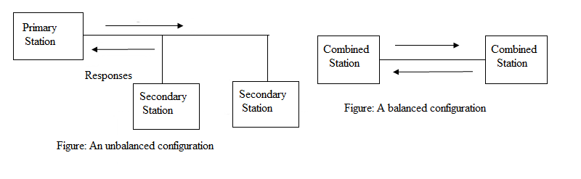
HDLC-link configuration
Unbalanced
  One primary and one or more secondary stations
  Supports full duplex and half duplex
Balanced
  Two combined stations
  Supports full duplex and half duplex

Slide 5
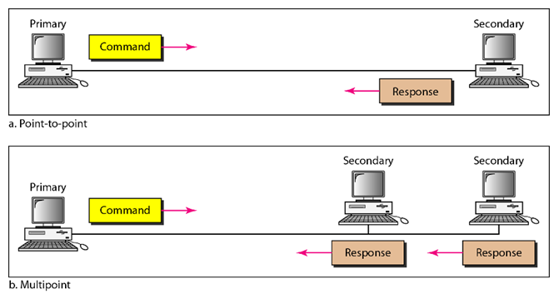
HDLC-Transfer Mode
Normal Response Mode (NRM)
The station configuration is unbalanced.
We have one primary station and multiple secondary stations.
A primary station can send command; a secondary station can only respond.
Used for both point-to-point and multiple-point links.
  Supports full duplex and half duplex

Slide 6
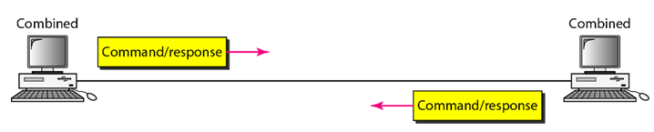
Asynchronous Balance Mode (ABM)
The station configuration is balanced.
The link is point-to-point.
Each station can function as a primary and a secondary.ry.

Slide 7
Asynchronous Balance Mode (ABM)
Describe the link configuration and transfer modes of HDLC.

Slide 8
Frames
To provide the flexibility necessary to support all the options possible in the modes and configurations, HDLC defines three types of frames: information frames (I-frames), supervisory frames (S-frames), and unnumbered frames (U-frames).
Information(I) frame - data to be transmitted to user
  -Acknowledgment is piggybacked on information frames (only positive acknowledgment)
Supervisory (S) frame – ARQ messages (RR/RNR/REJ/SREJ) when piggyback not used (actually only RR can be piggybacked; for the other, we need Supervisory frames)
Unnumbered (U) frame– supplementary link control functions. For examples,
  -Setting the modes
  -Disconnect

Slide 9
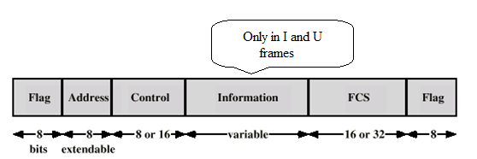
Frame Format
Each frame in HDLC may contain up to six fields
a beginning flag field,
an address field,
a control field,
an information field,
a frame check
sequence (FCS) field,
and an ending flag field.
In multiple-frame transmissions, the ending flag of one frame can serve as the beginning flag of the next frame.

Slide 10
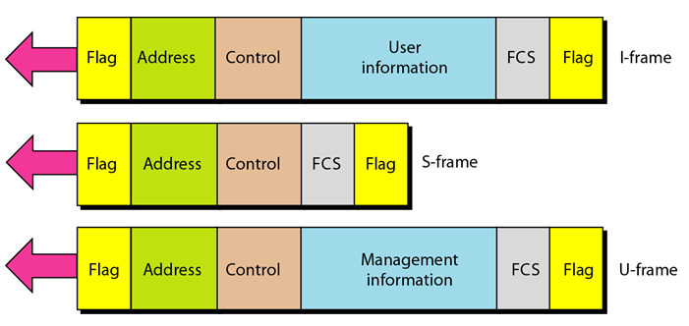
Frame Format

Slide 11
Fields- Flag
Delimit frame at both ends
01111110
Receiver hunts for flag sequence to synchronize
Bit stuffing used to avoid confusion with data containing 01111110
  -0 inserted after every sequence of five 1s
  -If receiver detects five 1s it checks next bit
    If 0, it is deleted
        If 1 and seventh bit is 0, accept as flag
If sixth and seventh bits 1, sender is indicating abort

Slide 12

Address field
Identifies secondary station that sent or will receive frame
Usually 8 bits long (but 7 bits are effective)
One byte can identify up to 128 stations (l bit is used for another purpose).
May be extended to multiples of 7 bits with prior agreement
  - leftmost bit of each octet indicates that it is the last octet (1) or not (0)

Slide 13
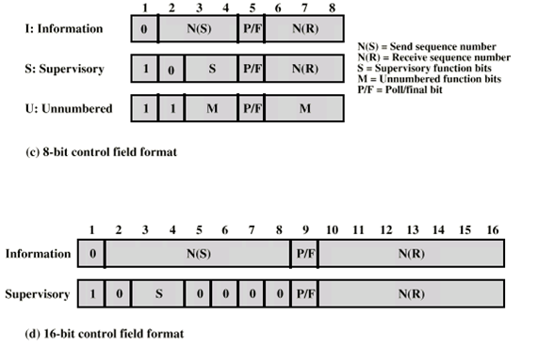
Control field
The control field is a 1- or 2-byte segment of the frame.
Used for flow and error control.
The interpretation of bits in this field depends on the frame type.

Slide 14

Control field for I frame
If the first bit of the control field is 0, this means the frame is an I-frame.
The next 3 bits, called N(S), define the sequence number of the frame.
The last 3 bits, called N(R), correspond to the acknowledgment number when piggybacking is used.
The single bit between N(S) and N(R) is called the P/F bit.
The P/F field is a single bit with a dual purpose. It has meaning only when it is set (bit = 1) and can mean poll or final.
It means poll when the frame is sent by a primary station to a secondary (when the address field contains the address of the receiver).
It means final when the frame is sent by a secondary to a primary (when the address field contains the address of the sender).

Slide 15
Control field for S frame
Supervisory frames are used for flow and error control whenever piggybacking is either impossible or inappropriate (e.g., when the station either has no data of its own to send or needs to send a command or response other than an acknowledgment).
If the first 2 bits of the control field is 10, this means the frame is an S-frame.
The last 3 bits, called N(R), corresponds to the acknowledgment number (ACK) or negative acknowledgment number (NAK) depending on the type of S-frame.
The 2 bits called code is used to define the type of S-frame itself.

Slide 16
Control field for S frame
With 2 bits, we can have four types of S-frames, as described below:
Receive ready (RR) frame acknowledges last I-frame received
    The value of the code subfield is 00.
    Indicating next I-frame expected
    Used when there is no reverse data
Receive not ready (RNR) acknowledges, but also asks peer to suspend transmission of I-frames
The value of the code subfield is 10.
    When ready, send RR to restart
REJ initiates go-back-N ARQ Indicates last I-frame received has been rejected
The value of the code subfield is 01
    Retransmission is requested beginning with N(R)
Selective reject (SREJ) requests retransmission of single frame
The value of the code subfield is 11
This is a NAK frame used in Selective Repeat ARQ.
The value of N(R) is the negative acknowledgment number.

Slide 17
Control field for U frame
Unnumbered frames are used to exchange session management and control information between connected devices.
U-frames contain an information field, but one used for system management information.
Much of the information carried by U-frames is contained in codes included in the control field.
U-frame codes are divided into two sections: a 2-bit prefix before the P/F bit and a 3-bit suffix after the P/F bit.
Together, these two segments (5 bits) can be used to create up to 32 different types of U-frames.

Slide 18
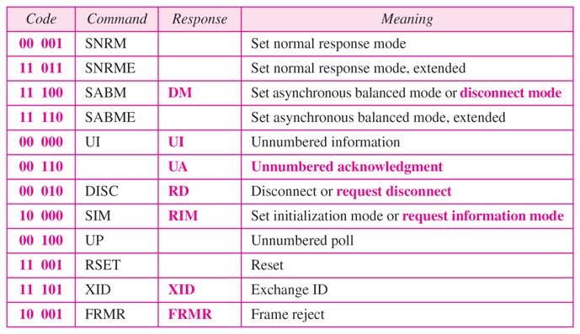
Control field for U frame
Some of the more common types

Slide 19
Information Field
Only in information and some unnumbered frames
Must contain integral number of octets
Variable length
Frame Check Sequence
Error detection
16 bit CRC
Optional 32 bit CRC

Slide 20
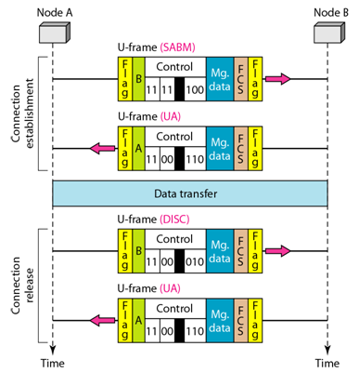
HDLC operation
Three phases: Initialization, Data transfer and disconnect.
Example of connection establishment and connection release

Slide 21
Cont.
Node A asks for a connection with a set asynchronous balanced mode (SABM) frame; node B gives a positive response with an unnumbered acknowledgment (UA) frame. After these two exchanges, data can be transferred between the two nodes (not shown in the figure). After data transfer, node A sends a DISC (disconnect) frame to release the connection; it is confirmed by node B responding with a UA (unnumbered acknowledgment).

Slide 22
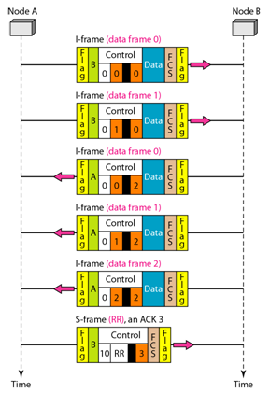
Example of piggybacking without error

Slide 23
Example of piggybacking without error-Cont.
Figure shows an exchange using piggybacking. Node A begins the exchange of information with an I-frame numbered 0 followed by another I-frame numbered 1. Node B piggybacks its acknowledgment of both frames onto an I-frame of its own. Node B’s first
I-frame is also numbered 0 [N(S) field] and contains a 2 in its N(R) field, acknowledging the receipt of A’s frames 1 and 0 and indicating that it expects frame 2 to arrive next. Node B transmits its second and third I-frames (numbered 1 and 2) before accepting further frames from node A.

Slide 24
Example of piggybacking without error-Cont.
Its N(R) information, therefore, has not changed: B frames 1 and 2 indicate that node B is still expecting A’s frame 2 to arrive next. Node A has sent all its data. Therefore, it cannot piggyback an acknowledgment onto an I-frame and sends an S-frame instead. The RR code indicates that A is still ready to receive. The number 3 in the N(R) field tells B that frames 0, 1, and 2 have all been accepted and that A is now expecting frame number 3.

Slide 25
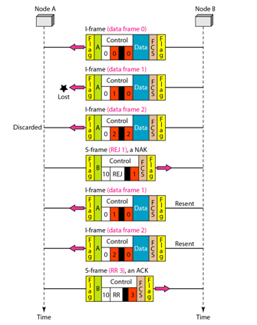
Example of piggybacking with error

Slide 26
Cont.
Figure shows an exchange in which a frame is lost. Node B sends three data frames (0, 1, and 2), but frame 1 is lost. When node A receives frame 2, it discards it and sends a REJ frame for frame 1. Note that the protocol being used is Go-Back-N with the special use of an REJ frame as a NAK frame. The NAK frame does two things here: It confirms the receipt of frame 0 and declares that frame 1 and any following frames must be resent.

Slide 27
Cont.
Node B, after receiving the REJ frame, resends frames 1 and 2. Node A acknowledges the receipt by sending an RR frame (ACK) with acknowledgment number 3.

